Slide 1
Insurance MarketPlace Data
Final Project Presentation
Barbara Zappala

Slide 2

Can we predict a health insurance plan price based on the number of benefits and network providers for that plan?

Slide 3
Data
Rate Data
Network Data
Benefit Data
PlanId IssuerId IndividualRate StateCode RatingAreaId Tobacco Age
Issuer Id
Network Count
Pland Id
Benefit Count
Clean Data

Slide 4
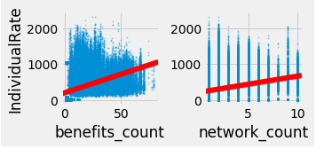
Data Model
Linear Regression Model with multiple features
Model: y = 125.2 + 28.3*(benefits_count) + 10*(network_count)

Slide 5
Performance Evaluation
Root Mean Squared Error represents the sample standard deviation of the differences between predicted values and observed values
Baseline | Root Mean Squared Error
Mean baseline | 337.8
Features | Root Mean Squared Error
Network_count | 324.4
Benefits_count | 299.86
Network_count & Benefits_count | 292.7

Slide 6
Next steps
Convert other possible features to numeric columns and look at impact in model
Explore polynomial options for model
Explore Random Forest Regressor option for model

